Slide 1

We are happy to present - Assessment of non-native pronunciation
Advanced Deep Learning Project by -
Group -2
Ram Charan, Rechita, Ram, Surya
Notes:
Save this document with a new name before you begin work.
When adding a new slide, click on the small arrow next to “New Slide” on the toolbar. Select the layout that will best fit the content you want to add.
Change the layout of an existing slide: click the “Layout” button on the top toolbar to reformat your existing content to another master slide.
Refer to utdallas.edu/brand for specific rules on using the University logos and wordmarks.

Slide 2

Why this topic?
1. Wide area of implementation; solves a real-world problem**
2. Extremely relatable for International students
3. Something additional for class – wave to vector
**Instance - “TOEFL, IELTS exams; automating the task”
Why should we care?

Slide 3
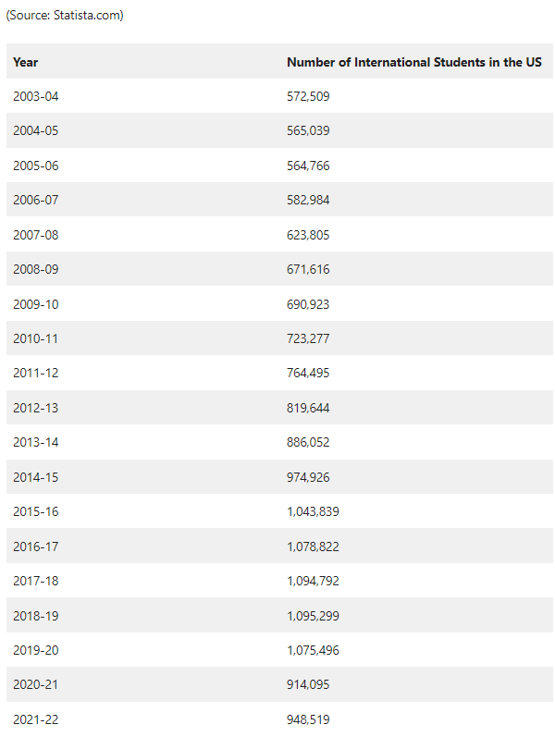
Let’s Talk Statistics –biggest market
Detailed number of international students - United States (over the years)
Approximately 1,075,496 international students attended American universities in the 2019–2020 academic year, making up 4.6% of all enrolled students in the country.
The combined 39 billion in economic contributions made by international students during the 2018–19 academic year supported over 400,000 jobs in the United States.
International students gave public universities $9 billion in 2015 or 28% of their entire revenue.
STEM programs are attended by about half of the foreign students studying in the United States.
And TOEFL/IELTS is required for each and every one of them!
Source: https://www.prosperityforamerica.org/international-students-in-the-us/
Notes:
Source: https://www.prosperityforamerica.org/international-students-in-the-us/

Slide 4
Evolution - Need for Standardization
Early methods of assessment
Language teaching, assessment was largely based on the teacher's own subjective judgment
Assessment NOT very RELIABLE; subjected to Human Bias
Development of standardized pronunciation tests
In 1950s & 1960s, growing interest in developing more objective methods
Result: development standardized pronunciation tests, such as the Michigan English Test and the Test of English as a Foreign Language (TOEFL – year 1964 to be exact!)
Recognition of the importance of fluency
Use of technology for assessment
Business Side Story
Topic of the day!

Slide 5
Why we need to access the pronunciations – Business Side story
Language Training and Development
Training of employees; within organization effective communications
Customer Service and Sales:
Helpful for businesses that deal with customers or clients from different linguistic backgrounds
International Presentations and Public Speaking
Crucial for engaging and influencing an audience
Cross-Cultural Communication
Pronunciation plays a significant role
Professional Image and Confidence
Crucial for establishing a professional image in the business world
EASY AND CHEAPER SOLUTION –
Computer Assisted Pronunciation Training
(CAPT)

Slide 6
Evolution of CAPT through time
Computer Assisted Pronunciation Training
1960s-1970s: Early research in phonetics and phonology laid the foundation for CAPT, with studies focused on acoustic models and algorithms for analyzing pronunciation. (Source: Hawkins, 1984)
1980s-1990s: Advancements in speech recognition technology enabled the development of CAPT systems that could accurately analyze and provide feedback on learners' pronunciation. (Source: Eskenazi, 2009)
1990s-early 2000s: Multimedia and computer-based training facilitated the development of interactive CAPT software programs that provided visual and auditory feedback on pronunciation. (Source: Levis, 2005)
2000s-2010s: Internet and mobile technologies revolutionized CAPT, making it accessible through online platforms and mobile apps, allowing for remote and on-the-go pronunciation practice. (Source: Neri et al., 2008)
2010s-present: Data-driven approaches utilizing big data and machine learning & Deep Learning techniques have been used to improve pronunciation assessment and feedback in CAPT. (Source: Kim et al., 2017)
Adaptive and personalized learning approaches have been incorporated into CAPT, tailoring training to individual learners' needs and abilities, and adapting content based on progress. (Source: Wang et al., 2016)
Integration with other technologies, such as virtual reality (VR), augmented reality (AR), and gamification, has been explored to create immersive and engaging CAPT experiences. (Source: Min et al., 2019)
Expanded language coverage, with CAPT now covering a wide range of languages beyond English, including Spanish, French, Chinese, etc., catering to diverse language learners. (Source: Kim et al., 2020)
Commercial applications, with CAPT being widely adopted in language learning apps, online courses, and pronunciation training programs offered by educational institutions and language training providers. (Source: Zheng et al., 2018)

Slide 7
Our approach for the problem
Outline – 1. We already discussed - Evolution of Computer Assisted Pronunciation Training (CAPT)
Coming Up!
2. Automatic Speech Recognition (ASR) - Evolution; Architecture and Advancements 3. Automatic Pronunciation Assessment (APA) - Goodness of Pronunciation (GOP) 4. Goodness of Pronunciation Transformer (GOPT) – Architecture; with Multi-view 5. Wave to Vector 6. Quick Demo
widely used in pronunciation
evaluation
& mispronunciation detection

Slide 8
Key terms to know -
Phoneme: Phonemes are like the building blocks of spoken language. They are the smallest units of sound that make up words. For example, the word "cat" has three phonemes: /k/ /æ/ /t/.
Utterance: An utterance is simply a spoken word or a group of spoken words. It can be a complete sentence, a phrase, or even just a single word that is spoken.
Prosody refers to the rhythmic and melodic aspects of speech, such as stress, intonation, pitch, rhythm, and timing, that convey meaning and emotion in spoken language. It adds expression and nuance to speech.
Acoustic model: An acoustic model is a computer program or algorithm that is trained to understand and process the sounds of human speech. It can analyze the audio signals produced by speech and convert them into text or other forms of data.
GOP features: GOP stands for "Goodness of Pronunciation" features. These are characteristics or measures that can be used to assess the quality of pronunciation, such as accuracy, fluency, prosody, stress, etc. GOP features are used in pronunciation assessment models to evaluate how well someone is pronouncing words or sentences in a foreign language.
CAPT: Stands for "Computer Assisted Pronunciation Training." It's a technology that helps non-native speakers learn foreign languages by providing feedback on their pronunciation. CAPT can be more convenient and cost-effective compared to traditional language classes, as it allows learners to practice their pronunciation and receive immediate feedback with the help of computer programs or applications.

Slide 9
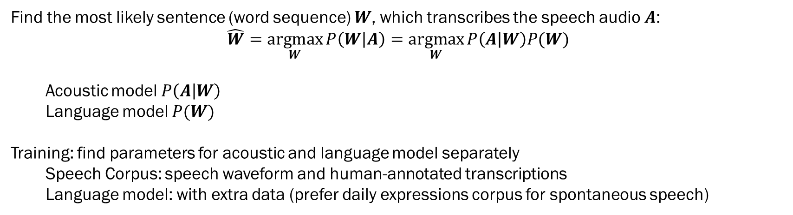
Background
Automatic Speech Recognition
Natural language interfaces for a more fluid and natural way to interact with computers
Alternative input medium for accessibility purposes
Voice Assistants (Siri, etc.), Automated telephony systems, Hands-free phone control in the car
Aim
Find the most likely sentence (word sequence) $W$, which transcribes the speech audio $A$:
$$\hat{W}=\underset{W}{argmax}{P\left(W | A\right)}=\underset{W}{argmax}{P\left(A | W\right)P(W)}$$
Acoustic model $P\left(A | W\right)$
Language model $P(W)$
Training: find parameters for acoustic and language model separately
Speech Corpus: speech waveform and human-annotated transcriptions
Language model: with extra data (prefer daily expressions corpus for spontaneous speech)

Slide 10
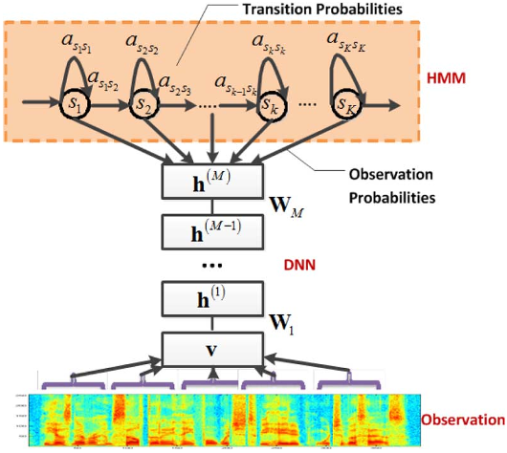
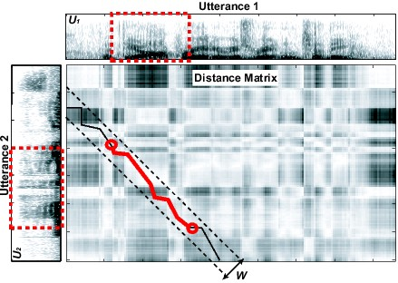
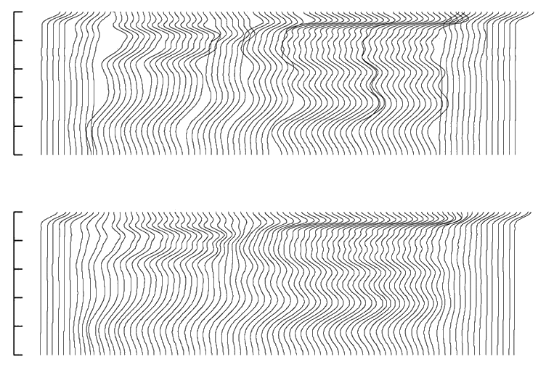
History of Automatic Speech Recognition
Early 1970s: Dynamic Time Warping (DTW) : Time variability
Mid-Late 1970s: Hidden Markov Models (HMMs) –Modelling spectral variations
Mid 1980s: HMMs become the dominant technique for all ASR
1990s: Large vocabulary continuous dictation
2000s: Discriminative training (minimize word/phone error rate)
2010s: Deep learning significantly reduce error rate
sil
a
i
sil
0
1
2
(kHz)
3
4
5

Slide 11
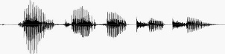
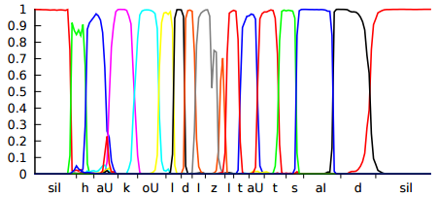
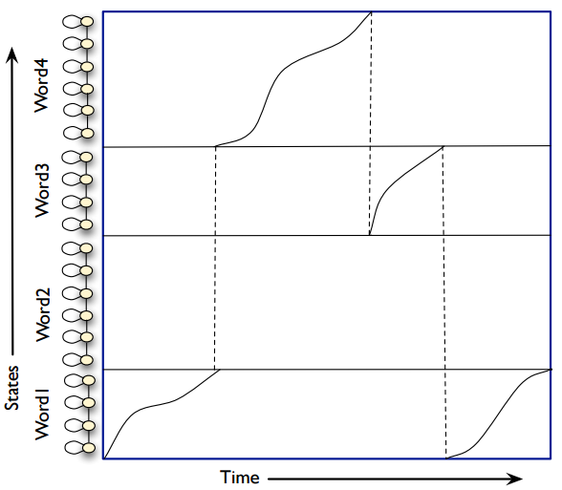
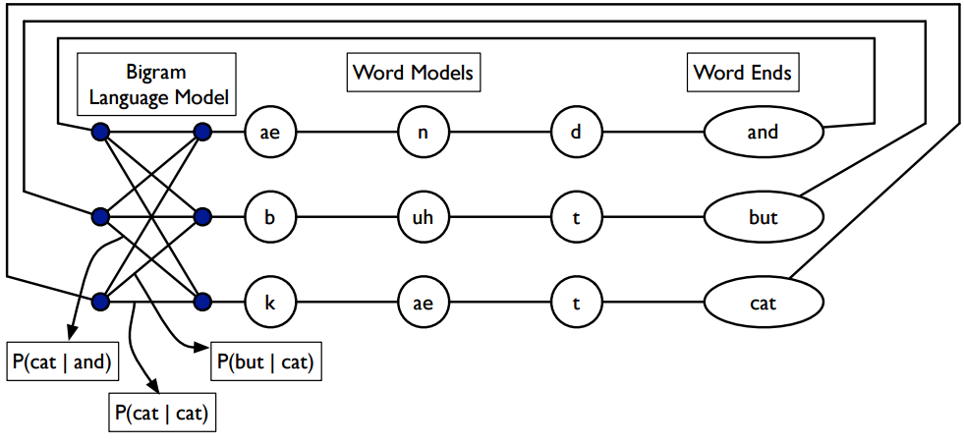
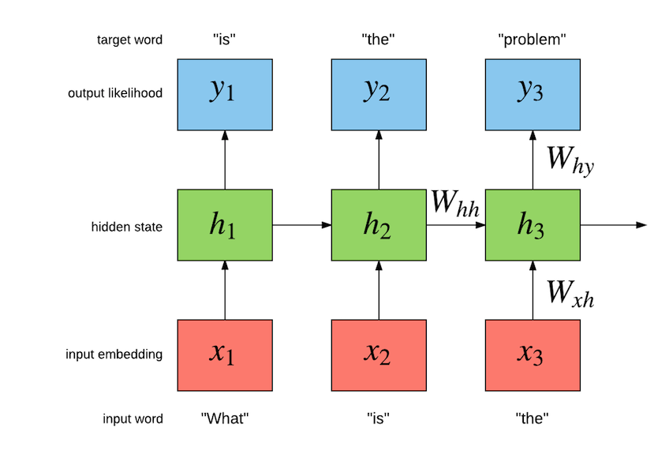
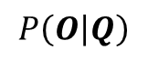
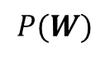
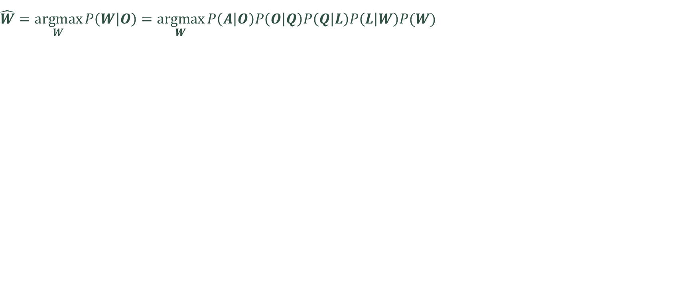
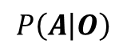
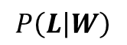

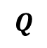
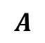

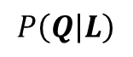

ASR: Architecture – 5. Lang Models
$$\hat{W}=\underset{W}{argmax}{P\left(W | O\right)}=\underset{W}{argmax}{P\left(A | O\right)P\left(O | Q\right)P\left(Q | L\right)P\left(L | W\right)P(W)}$$
$$P\left(A | O\right)$$
$$P\left(O | Q\right)$$
$$P\left(Q | L\right)$$
$$P\left(L | W\right)$$
$$P(W)$$
Feature
Extraction
Frame
Classification
Sequence
Model
Lexicon
Model
Language
Model
t ah m aa t ow
$$A$$
$$O$$
$$Q$$
$$L$$
$$W$$
Speech Audio
Feature Frames
Sequence States
Phonemes
Words
Sentence
Without language models
(Dynamic programing)
With language models

Slide 12
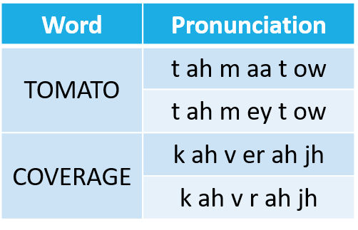
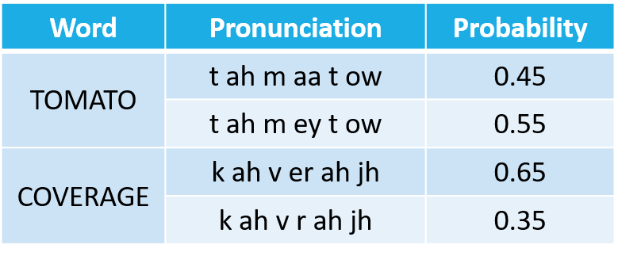
ASR: Architecture – 4. Lexicon Model
$$\hat{W}=\underset{W}{argmax}{P\left(W | O\right)}=\underset{W}{argmax}{P\left(A | O\right)P\left(O | Q\right)P\left(Q | L\right)P\left(L | W\right)P(W)}$$
$$P\left(A | O\right)$$
$$P\left(O | Q\right)$$
$$P\left(Q | L\right)$$
$$P\left(L | W\right)$$
$$P(W)$$
Feature
Extraction
Frame
Classification
Sequence
Model
Lexicon
Model
Language
Model
t ah m aa t ow
$$A$$
$$O$$
$$Q$$
$$L$$
$$W$$
Speech Audio
Feature Frames
Sequence States
Phonemes
Words
Sentence
Lexical model : bridges acoustic model -> language models.
Mapping between words and the acoustic units (phoneme is most common)
Deterministic Probabilistic

Slide 13
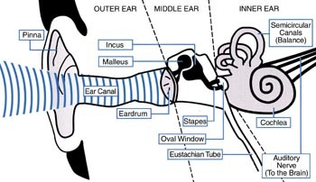
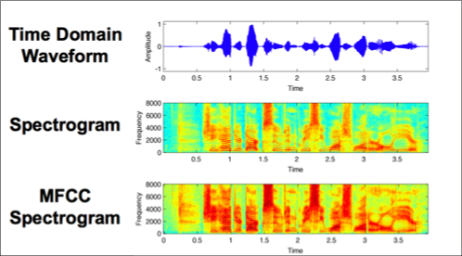
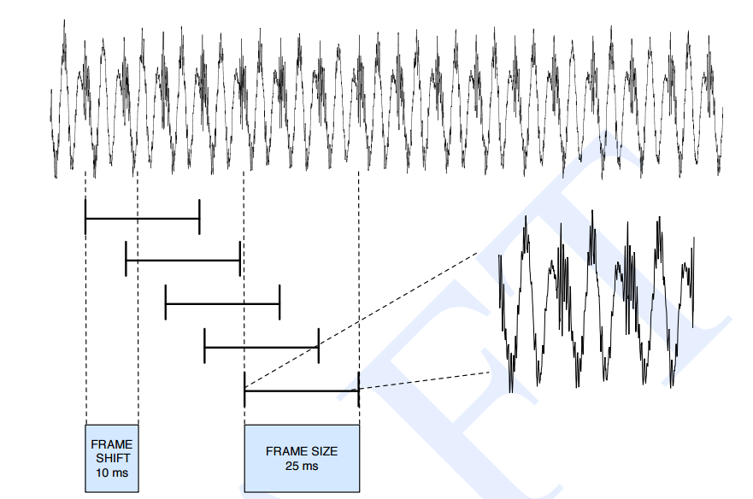
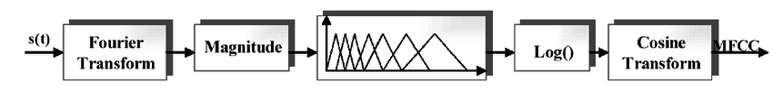
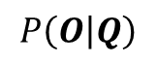
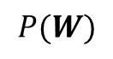
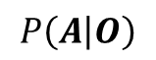
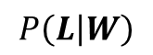
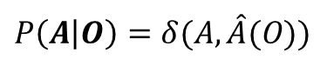
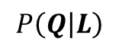
ASR: Architecture – 1. Feature Extraction
$$\hat{W}=\underset{W}{argmax}{P\left(W | O\right)}=\underset{W}{argmax}{P\left(A | O\right)P\left(O | Q\right)P\left(Q | L\right)P\left(L | W\right)P(W)}$$
$$P\left(A | O\right)$$
$$P\left(O | Q\right)$$
$$P\left(Q | L\right)$$
$$P\left(L | W\right)$$
$$P(W)$$
Feature
Extraction
Frame
Classification
Sequence
Model
Lexicon
Model
Language
Model
t ah m aa t ow
$$A$$
$$O$$
$$Q$$
$$L$$
$$W$$
Speech Audio
Feature Frames
Sequence States
Phonemes
Words
Sentence
$$P\left(A | O\right)=δ(A,\hat{A}(O))$$
Reduce information rate
Remove noise (SAD)

Slide 14
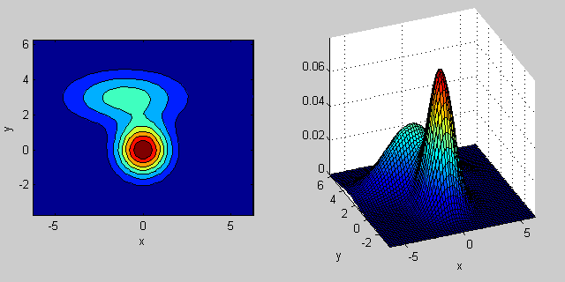
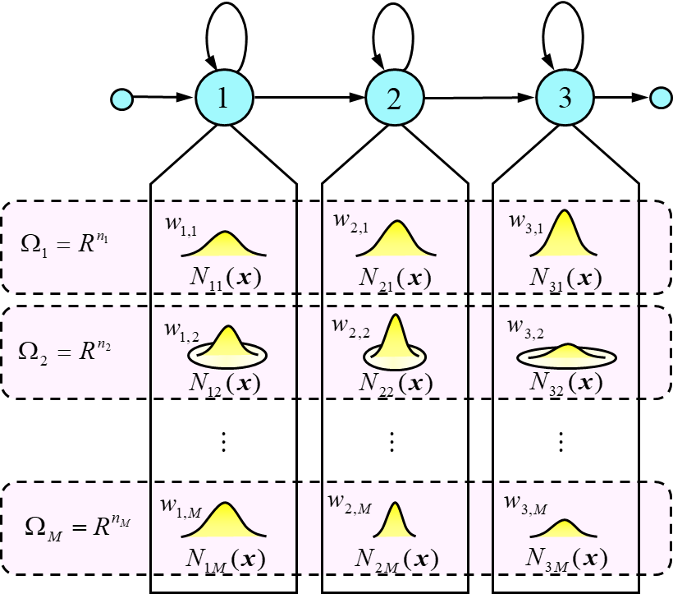
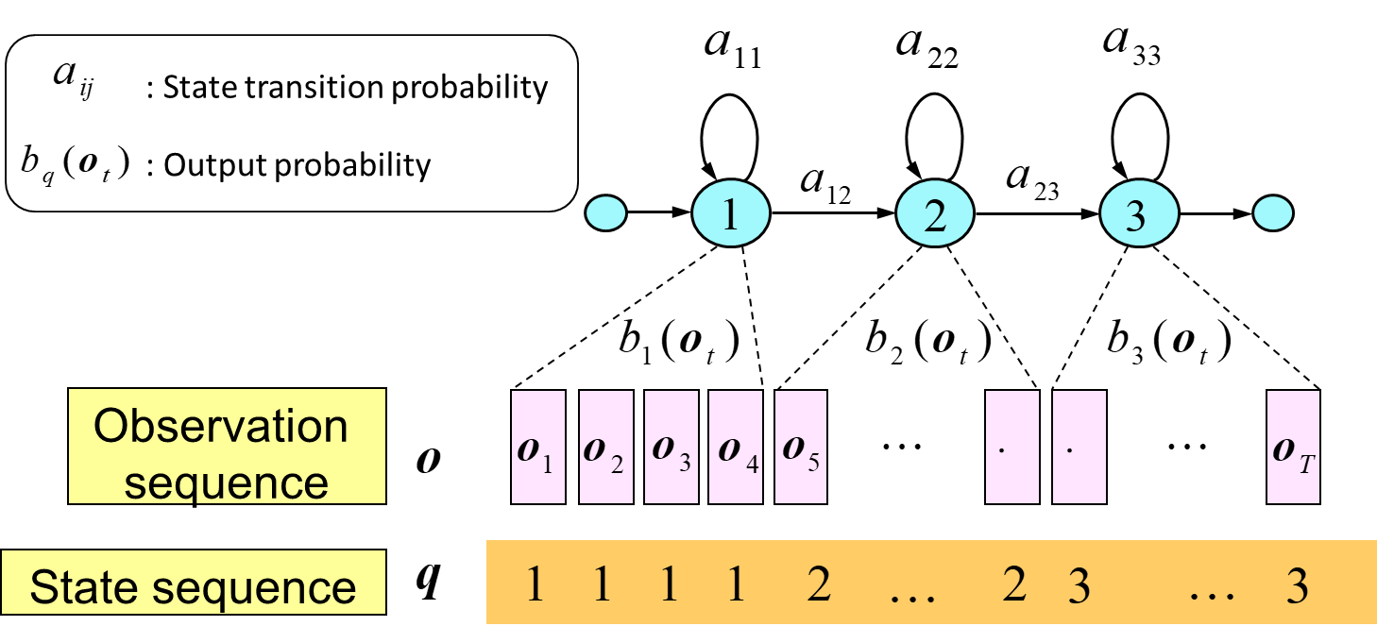
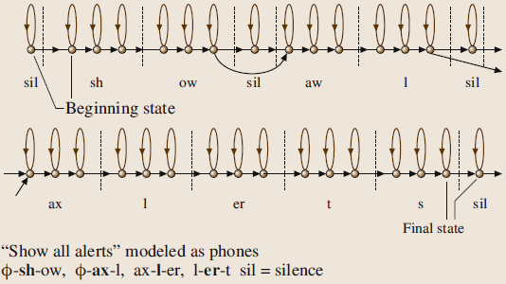
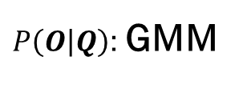
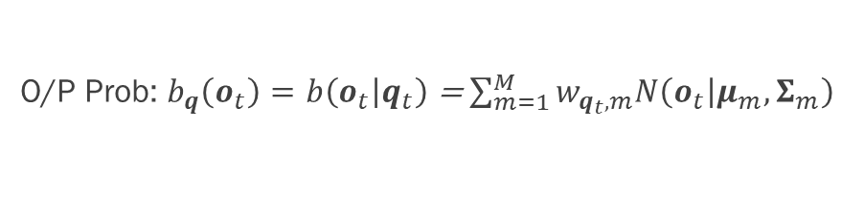
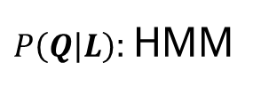
ASR: Architecture – GMM-HMM
Acoustic Model
$$\hat{W}=\underset{W}{argmax}{P\left(W | O\right)}=\underset{W}{argmax}{P\left(A | O\right)P\left(O | Q\right)P\left(Q | L\right)P\left(L | W\right)P(W)}$$
$$P\left(A | O\right)$$
$P\left(O | Q\right)$: GMM
$P\left(Q | L\right)$: HMM
$$P\left(L | W\right)$$
$$P(W)$$
Feature
Extraction
Frame
Classification
Sequence
Model
Lexicon
Model
Language
Model
t ah m aa t ow
$$A$$
$$O$$
$$Q$$
$$L$$
$$W$$
Speech Audio
Feature Frames
Sequence States
Phonemes
Words
Sentence
Gaussian Mixture Models
Hidden Markov Model: Markov chain with unknown state sequence
O/P Prob: $b_{q}\left(o_{t}\right)=b\left(o_{t} | q_{t}\right)$ = $\sum_{m=1}^{M}{w_{q_{t},m}N\left(o_{t} | μ_{m},Σ_{m}\right)}$

Slide 15
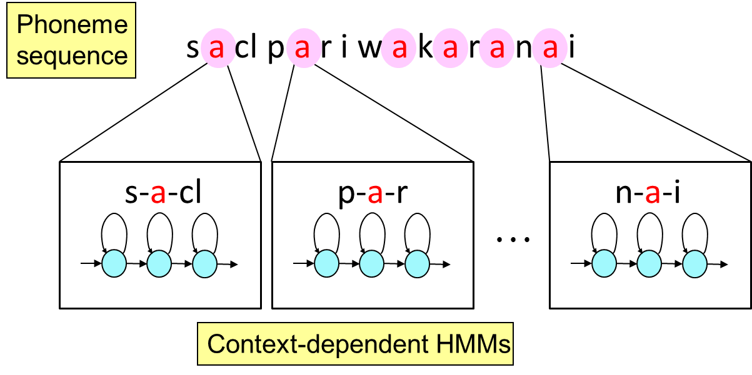
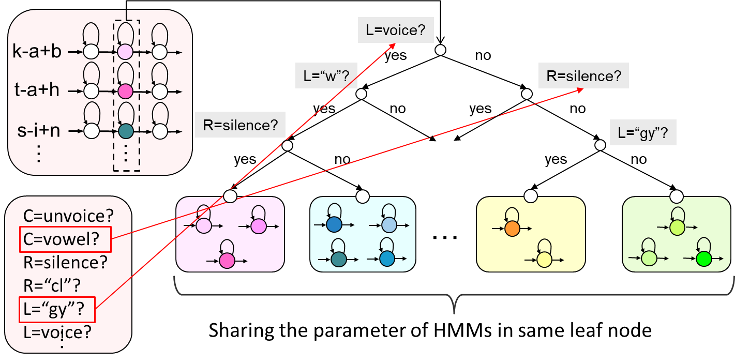
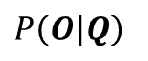
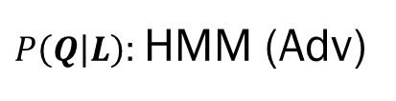
ASR: Architecture – 3. Sequence Model (HMM Advanced)
$$\hat{W}=\underset{W}{argmax}{P\left(W | O\right)}=\underset{W}{argmax}{P\left(A | O\right)P\left(O | Q\right)P\left(Q | L\right)P\left(L | W\right)P(W)}$$
$$P\left(A | O\right)$$
$P\left(O | Q\right)$
$P\left(Q | L\right)$: HMM (Adv)
$$P\left(L | W\right)$$
$$P(W)$$
Feature
Extraction
Frame
Classification
Sequence
Model
Lexicon
Model
Language
Model
English
#Monophone : 46
#Biphone: 2116
#Triphone: 97336
t ah m aa t ow
$$A$$
$$O$$
$$Q$$
$$L$$
$$W$$
Speech Audio
Feature Frames
Sequence States
Phonemes
Words
Sentence
Decision Tree-based State Clustering
‘a’ varies but similar patterns occur in similar context

Slide 16
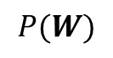
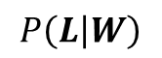
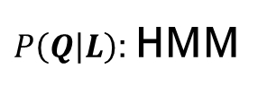
ASR: Architecture – Complete GMM HMM
$$\hat{W}=\underset{W}{argmax}{P\left(W | O\right)}=\underset{W}{argmax}{P\left(A | O\right)P\left(O | Q\right)P\left(Q | L\right)P\left(L | W\right)P(W)}$$
$$P\left(A | O\right)$$
$P\left(O | Q\right)$: GMM
$P\left(Q | L\right)$: HMM
$$P\left(L | W\right)$$
$$P(W)$$
Feature
Extraction
Frame
Classification
Sequence
Model
Lexicon
Model
Language
Model
t ah m aa t ow
$$A$$
$$O$$
$$Q$$
$$L$$
$$W$$
Speech Audio
Feature Frames
Sequence States
Phonemes
Words
Sentence
Acoustic Model
Pronunciation/Lexicon Model
Language Model
Intra-word
transition
start
Word
transition
I
ill
I
L
I
end
P(I|x)
I
L
I
I
l
LM is applied
S
ill
P(ill|x)
I
L
ill
Sam
S
A
M
A
SAM
P(SA|x)
M
SA
S
A
SA
Between-word
transition
S
A
SA
P(SAM|x)
S
A
M
SAM

Slide 17
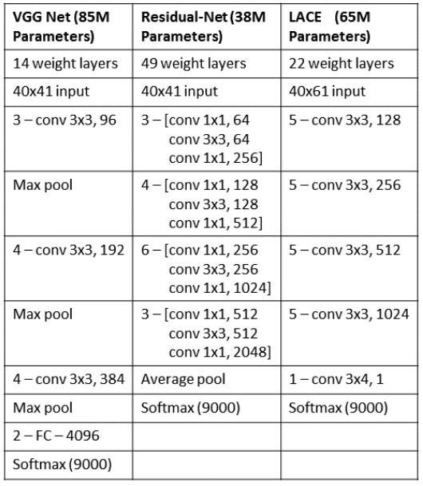
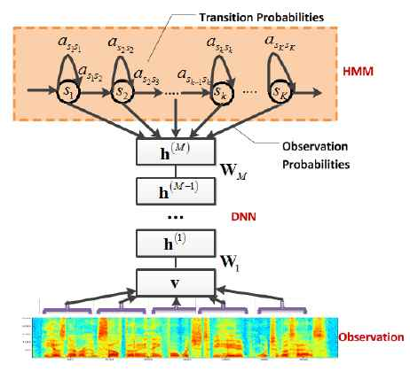
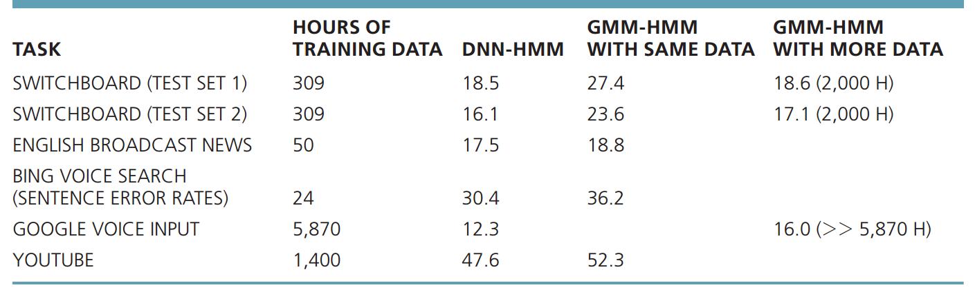
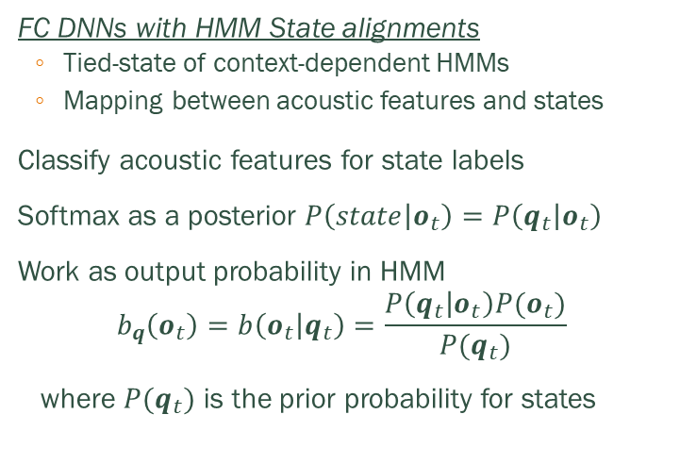
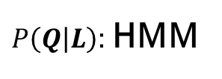
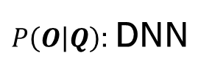
ASR: Architecture – DNN-HMM
$$\hat{W}=\underset{W}{argmax}{P\left(W | O\right)}=\underset{W}{argmax}{P\left(A | O\right)P\left(O | Q\right)P\left(Q | L\right)P\left(L | W\right)P(W)}$$
$$P\left(A | O\right)$$
$P\left(O | Q\right)$: DNN
$P\left(Q | L\right)$: HMM
$$P\left(L | W\right)$$
$$P(W)$$
Feature
Extraction
Frame
Classification
Sequence
Model
Lexicon
Model
Language
Model
t ah m aa t ow
$$A$$
$$O$$
$$Q$$
$$L$$
$$W$$
Speech Audio
Feature Frames
Sequence States
Phonemes
Words
Sentence
FC DNNs with HMM State alignments
Tied-state of context-dependent HMMs
Mapping between acoustic features and states
Classify acoustic features for state labels
Softmax as a posterior $P\left(state | o_{t}\right)=P\left(q_{t} | o_{t}\right)$
Work as output probability in HMM
$$b_{q}\left(o_{t}\right)=b\left(o_{t} | q_{t}\right)=\frac{P\left(q_{t} | o_{t}\right)P(o_{t})}{P(q_{t})}$$
where $P(q_{t})$ is the prior probability for states
WER for 1D CNN {7L, 2048N, sigmoid} [1].
[1] G. Hinton, et al. Deep Neural Networks for Acoustic Modeling in Speech Recognition. Signal Processing Magazine (2012).
Notes:
Ingredients for Deep Learning
Acoustic features
Frequency domain features extracted from waveform
10ms interval between frames
~40 dimensions for each frame
State alignments
Tied-state of context-dependent HMMs
Mapping between acoustic features and states
DNN-HMM vs. GMM-HMM
Deep models are more powerful
GMM assumes data is generated from single component of mixture model
GMM with diagonal variance matrix ignores correlation between dimensions
Deep models take data more efficiently
GMM consists with many components and each learns from a small fraction of data
Deep models can be further improved by recent advances in deep learning
Limitations of DNN-HMM
Markov models only depend one previous states
History is discretely represented by 10k states
Decoding is slow to keep all 10k state in dynamic programing

Slide 18







ASR: Architecture – RNN-CTC
$$\hat{W}=\underset{W}{argmax}{P\left(W | O\right)}=\underset{W}{argmax}{P\left(A | O\right)P\left(O | Q\right)P\left(Q | L\right)P\left(L | W\right)P(W)}$$
$$P\left(A | O\right)$$
$P\left(O | Q\right)$: RNN
$P\left(Q | L\right)$: CTC
$$P\left(L | W\right)$$
$$P(W)$$
Feature
Extraction
Frame
Classification
Sequence
Model
Lexicon
Model
Language
Model
t ah m aa t ow
$$A$$
$$O$$
$$Q$$
$$L$$
$$W$$
Speech Audio
Feature Frames
[1]
Sequence States
[2]
Phonemes
Words
[2]
Sentence
RNN
[1]
[1] Amodei, Dario, et al. "Deep speech 2: End-to-end speech recognition in english and mandarin." arXiv preprint arXiv:1512.02595 (2015).
[2] H. Sak, A. Senior, and F. Beaufays. Long Short-Term Memory Recurrent Neural Network Architectures for Large Scale Acoustic Modeling. arXiv preprint arXiv:1402.1128v1 (2014).

Slide 19




Connectionist Temporal Classification (CTC)
Introduction
Method for labeling unsegmented data sequences
Differentiable objective function & Gradient based training
$O^{ML}\left(S, 𝒩_{w}\right)=−\sum_{\left(x,z\right)∈S}{\ln\left(p\left(z | x\right)\right)}$
Applications: DeepSpeech (ASR) & DeepVoice(TTS)
Training examples $S=\left\{\left(x_{1},z_{1}\right), …\left\{x_{N}, z_{N}\right\}\right)∈𝒟_{𝒳×𝒵}$
$x∈𝒳$ are waveforms
$z∈𝒵$ are text transcripts
Goal: train temporal classifier $h : 𝒳 → 𝒵$
Architecture
Input layer accepts audio frame (Raw waveforms )
Some network (usually CNN or RNN)
Softmax output over phones (or text transcription)

Slide 20










Connectionist Temporal Classification (CTC)
$$l=\{a\}$$
$$l=\{bee\}$$
CTC embeds history in continuous hidden space, more capable than HMM
CTC has spiky predictions, more discriminable between states than HMM
CTC with less states (40) is significantly faster for decoding than HMM (10k)
HMM
CTC
Notes:
$𝒩_{w}\left(x\right)=\{y_{k}^{t}\}$ -> NN softmax output $; y_{k}^{t}$ - o/p activation $k$ at time frame $t$
Activations over time define distribution over $L^{T}$
Sequences distributed over $L^{T}≜π=\{π_{1}, …, π_{T}\}$ are paths
Optimize for best path: $P\left(π | x\right)= \prod_{t=1}^{T}{y_{π_{t}}^{t}, ∀π∈L^{T}}$
Paths are not equivalent to the label, $π≠l$
Optimize for best label: $P\left(l | x\right)=\sum_{π}{P\left(l | π\right)P\left(π | x\right)}$
Solve objective above with dynamic time warping
Forward-backward algorithm : Forward variables $α$; Backward variables $β$
$P\left(l | x\right)=\sum_{s=1}^{|l|}{\frac{α_{t}\left(s\right)β_{t}\left(s\right)}{y_{l_{s}}^{t}}}$
Maps and searches only paths that correspond to target label
Objective function:$O^{ML}\left(S, 𝒩_{w}\right)=−\sum_{\left(x,z\right)∈S}{\ln\left(p\left(z | x\right)\right)}$
Gradient: $\frac{∂O^{ML}\left(\{\left(x,z\right)\}, 𝒩_{w}\right)}{∂u_{k}^{t}}=y_{k}^{t}−\frac{1}{y_{k}^{t}Z_{t}}\sum_{s∈lab\left(z,k\right)}{{\hat{α}}_{t}\left(s\right){\hat{β}}_{t}\left(s\right)}\text{, }\text{where} Z_{t}≜\sum_{s=1}^{|l^{′}|}{\frac{α_{t}\left(s\right)β_{t}\left(s\right)}{y_{l_{s}^{′}}^{t}}}$
CTC embeds history in continuous hidden space, more capable than HMM
CTC has spiky predictions, more discriminable between states than HMM
CTC with less states (40) is significantly faster for decoding than HMM (10k states)

Slide 21











ASR Evolution: GMM-HMM – End-to-End Deep Models
$$\hat{W}=\underset{W}{argmax}{P\left(W | O\right)}=\underset{W}{argmax}{P\left(A | O\right)P\left(O | Q\right)P\left(Q | L\right)P\left(L | W\right)P(W)}$$
Attention
RNN-CTC
$$GMMs$$
DNN-HMMs
HMMs
$$P\left(A | O\right)$$
$$P\left(O | Q\right)$$
$$P\left(Q | L\right)$$
$$P\left(L | W\right)$$
$$P(W)$$
Feature
Extraction
Frame
Classification
Sequence
Model
Lexicon
Model
Language
Model
t ah m aa t ow
$$A$$
$$O$$
$$Q$$
$$L$$
$$W$$
Speech Audio
Feature Frames
Sequence States
Phonemes
Words
Sentence

Slide 22












Automatic Pronunciation Assessment (APA)
$$\hat{W}=\underset{W}{argmax}{P\left(W | O\right)}=\underset{W}{argmax}{P\left(A | O\right)P\left(O | Q\right)P\left(Q | L\right)P\left(L | W\right)P(W)}$$
Native ASR
Attention
RNN-CTC
$$GMMs$$
DNN-HMMs
HMMs
$$P\left(A | O\right)$$
$$P\left(O | Q\right)$$
$$P\left(Q | L\right)$$
$$P\left(L | W\right)$$
$$P(W)$$
Feature
Extraction
Frame
Classification
Sequence
Model
Lexicon
Model
Language
Model
t ah m aa t ow
PRONUNCIATION SCORE
$$A$$
$$O$$
$$Q$$
$$L$$
$$W$$
Speech Audio
Feature Frames
Sequence States
Phonemes
Words
Sentence
$$Factors in Pronunciation:$$
Multi aspects – Fluency, Prosody, Stress.
Multi-Granularities: Phone, Word, Utterance (Sentence)

Slide 23









APA: Goodness of Pronunciation
Goodness of Pronunciation (GoP) is widely used in pronunciation evaluation and mispronunciation detection.
GoP is a variation of posterior probability for phone level pronunciation scoring.
GOP-GMM
GOP-DNN:
Log Phone Posterior (LPP)
Log Posteriori Ratio (LPR)
Phone-level Feature:
Notes:
The numerator of the equation is calculated from forced alignment result and the denominator is calculated from an Viterbi decoding with a unconstrained phone loop.
We do not implement GOP-GMM for Kaldi, as GOP-NN performs much better than GOP-GMM.

Slide 24








Transformer Encoder:
3 Layers , 24-dim Embedding
GoP Projection: 24-dim dense layer
Gong, Y., Chen, Z., Chu, I. H., Chang, P., & Glass, J. (2022, May). Transformer-based multi-aspect multi-granularity non-native English speaker pronunciation assessment. In ICASSP 2022-2022 IEEE International Conference on Acoustics, Speech and Signal Processing (ICASSP) (pp. 7262-7266). IEEE.
Notes:
An overview of the GOPT architecture is shown in Figure 1.
For the pronunciation assessment task, the canonical transcription
is known. We first input the audio and corresponding
canonical transcription to the acoustic module to get a sequence
of frame-level phonetic posterior-probabilities, which
are then force-aligned at the phoneme-level and converted
to 84-dimensional goodness of pronunciation (GOP) features
(discussed in Section 3.3). The GOP feature is then projected
to 24-dimensions with a dense layer. In parallel, we generate
a sequence of canonical phoneme embeddings (also at the
phoneme-level) by first converting each canonical phoneme
to a one-hot encoding and then projecting it to the same 24-
dimensions as the projected GOP feature. The reason for
using a canonical phoneme embedding is because different
phonemes have different characteristics and thus the canonical
phoneme provides useful information to the Transformer
model [21]. We then add the projected GOP feature, canonical
phoneme embedding, and a 24-dimensional trainable positional
embedding together and input it to the Transformer
encoder. For simplicity, we intentionally follow the original
Transformer encoder architecture [17] as close as possible but
scale it down to 3 layers and an embedding dimension of 24.
Unlike previous work [19, 21] that use a hierarchical architecture
to get utterance level representations, we prepend a
set of five trainable [cls] tokens to the phoneme-level input
sequence in a similar way as BERT [23], each corresponding
to one utterance aspect label, and use the output of the Transformer
encoder of these [cls] aspect tokens as the corresponding
utterance-level representations. The reason why this
regime works is that the Transformer can learn the correlation
between the utterance-level tokens and phoneme-level tokens
through the attention mechanism.
During training we apply multi-task learning to the
model. Specifically, we use one regression head for each
phoneme, word, and utterance label (eight in total). Each
regression head is a 24 1 dense layer with layer normalization.
Utterance-level regression heads are added on top
of the output of the Transformer of the corresponding utterance
[cls] tokens. Phoneme- and word-level regression
heads are added on top of the Transformer output of each
corresponding phoneme. We propagate the word score to
each of its phonemes during training and average the output
of phonemes that belong to the word in inference. We
use mean squared error (MSE) loss for each assessment
task. Since we normalize the scores to the same scale,
for simplicity, we first average the losses of each granularity
and then sum them up with the same weight L

Slide 25





GOP: Kaldi
GOPT: Train
GOP Feat Scoring
GOP t-SNE
Notes:
The numerator of the equation is calculated from forced alignment result and the denominator is calculated from an Viterbi decoding with a unconstrained phone loop.
We do not implement GOP-GMM for Kaldi, as GOP-NN performs much better than GOP-GMM.

Slide 26
Goodness of Pronunciation Transformer
Notes:
The numerator of the equation is calculated from forced alignment result and the denominator is calculated from an Viterbi decoding with a unconstrained phone loop.
We do not implement GOP-GMM for Kaldi, as GOP-NN performs much better than GOP-GMM.

Slide 27


Advanced GOPT with Multi-view
Advanced Features
Prosodic Features: Duration & Energy
Self Supervised Feats
Wav2Vec2.0
HuBERT
WavLM
Chao, F. A., Lo, T. H., Wu, T. I., Sung, Y. T., & Chen, B. (2022, November). 3M: An Effective Multi-view, Multi-granularity, and Multi-aspect Modeling Approach to English Pronunciation Assessment. In 2022 Asia-Pacific Signal and Information Processing Association Annual Summit and Conference (APSIPA ASC) (pp. 575-582). IEEE.
Notes:
The numerator of the equation is calculated from forced alignment result and the denominator is calculated from an Viterbi decoding with a unconstrained phone loop.
We do not implement GOP-GMM for Kaldi, as GOP-NN performs much better than GOP-GMM.

Slide 28

Wav2vec 2.0
This model used self-supervision to learn
representations of speech signals and achieved
state-of-the-art
results on various speech processing tasks.
This model improved upon the original
Wav2vec model
by using a contrastive loss function
and achieved state-of-the-art results on
various speech processing tasks.
This model achieved state-of-the-art
results on various NLP tasks and
is still widely used today.
This model revolutionized the field (NLP)
and became the foundation for many
subsequent models.
This model learned representations of
speech signals without using any transcriptions,
making it useful for
unsupervised learning tasks.
This model used vector quantization to discretize
the representations learned by the Wav2vec model,
improving its performance on
downstream speech processing tasks.

Slide 29
Self-supervised Learning (SSL) Features
Wav2vec Architecture
Efficiently represent the raw audio data as a vector space encoding
The complete architecture of the framework can be divided into 3 components, they are
Feature encoder:
This is the encoder part of the model. It takes the raw audio data as input and outputs feature vectors.
Transformers:
The output of the feature encoder is passed on to a transformer layer. One differentiator is use of relative positional embedding by using convolution layers, rather than using fixed positional encoding as done in original Transformers paper.
Quantization module:
For self-supervised learning, we need to work with discrete outputs. For this, there is a quantization module that converts the continous vector output to discrete representations, and on top of it, it automatically learns the discete speech units.

Slide 30
Wav2vec Training
To pre-train the model, Wav2Vec2 masks certain portions of time steps in the feature encoder which is similar to masked language model. The aim is to teach the model to predict the correct qunatized latent audio representation in a set of distractors for each time step.
The overall training objective is to minimize contrastive loss and diversity loss. Contrastive loss is the performance on the self-supervised task. Diversity loss is designed to increase the use of the complete quantized codebook representations, and not only a select subset.
For pretraining, the datasets used were
Librispeech corpus with 960 hours of audio data,
LibriVox 60k hours of audio data that was later subset to 53.2k hours. Only unlabeled data was used for pretraining.
The model is optimized by minimizing the CTC loss.
Adam was used as optimization algorithm and the learning rate is warmed up till 10% of the training duration, then kept constant for next 40% and finally linearly decayed for the remaining duration. Also, for the first 60k updates only output classifier was trained after which Transformer is also updated. The feature encoder is kept frozen (not trained at all).
.

Slide 31



Wav2vec Results
There are two interesting points to note from the results of the Wav2Vec2 model,
The model is able to learn ASR with as minimum as 10 mins of labeled data! As shown below, LARGE model pre-trained on LV-60k and finetuned on Librispeech with CTC loss is giving 4.6/7.9 WER! This is a very good news incase you want to finetune the model for your domain or accent!
The choice of decoder can lead to improvement in performance. As obvious from the results, Transformer decoder is giving best performance, followed by n-gram and then CTC decoding.

Slide 32

HuBERT
HuBERT has the same structure as Wav2vec 2.0 but uses different training strategies.
It outperforms Wav2vec 2.0 in various tasks, and the main difference between the two models is that HuBERT only applies the prediction loss over the masked region.
HuBERT uses iterative refinement strategy on predicting target labels, which uses K-means on either MFCC based acoustic features or the hidden units of Transformer to learn discriminative acoustic representations.
WavLM
WavLM is an extension of HuBERT that is designed to learn masked prediction and speech denoising capabilities simultaneously.
It adds gated relative position bias to the Transformer structure and uses noisy and overlapped speech as extra data augmentations in the pre-training phase.
WavLM obtained significant results on the full-stack downstream speech tasks of speech processing.
Multi-view modeling and fusion mechanism
The paper extracts SSL features from Wav2vec 2.0, HuBERT, and WavLM, respectively, and collaborates with other phone-level acoustic features to provide multiple views on the L2 learner’s pronunciation.
A simple concatenation of all features is used as the fusion mechanism, followed by a projection layer to encapsulate these features into a 24-dimensional embedding for subsequent modeling.
The resulting multi-view representation can be used to model the L2 learner's pronunciation.

Slide 33

Wav2vec Demo

Slide 34



Phoneme Recognition on TIMIT
Evaluate the accuracy of their approach on TIMIT phoneme recognition by fine-tuning the pre-trained models on the labeled TIMIT training data. They compare their results with other recent work on pre-training which evaluates on TIMIT.
Fine-tune the pre-trained models on TIMIT phoneme recognition and achieve a new state of the art on this dataset.
The proposed approach reduces PER by a relative 23%/29% over the next best result on the dev/test sets.
Another recent work on pre-training also evaluates on TIMIT, where we solve multiple tasks to learn good representations of speech.
TIMIT phoneme recognition accuracy in terms of phoneme error rate (PER).
Average WER and standard deviation on combined dev-clean/other of Librispeech for three
training seeds.

Slide 35


The study compares the correlation between assessment measures of human expert annotations and a proposed 3M model for pronunciation assessment.
The results show that the proposed 3M model can achieve approximate pronunciation assessments as that done by human experts.
However, there are mismatches between the expert annotations and the model predictions, and a hierarchical modeling structure or a selective attention mechanism may be more suitable for better modeling of different granularities.
Correlation matrices on expert annotations and the 3M model predictions.

Slide 36
CONCLUSION
Wav2vec 2.0 is a self-supervised learning framework for speech representations that masks latent representations of raw waveform and solves a contrastive task over quantized speech representations.
The model achieves state-of-the-art results on the Librispeech benchmark for noisy speech and outperforms previous best results on the clean 100 hour Librispeech setup while using 100 times less labeled data.
The approach is effective with small amounts of labeled data and can potentially improve performance by using a seq2seq architecture and a word piece vocabulary.
The study introduces a new approach called 3M, which is a multi-view, multi-aspect, and multi-granularity approach for automatic pronunciation assessment.
The approach is tested on the speechocean762 benchmark dataset, and it is shown to improve the assessment performance at three different levels of granularity.
The approach is particularly effective in scoring speaking fluency and speech prosody, which are highly correlated to the proficiency of L2 language learners.
The results suggest that the 3M approach can provide a promising avenue for future research on CAPT developments.
In the future, the we plan to explore the feasibility of equipping 3M with a hierarchical modeling structure for pronunciation assessment.
Overall, the study presents a novel and effective approach for automatic pronunciation assessment that has the potential to contribute to the field of CAPT.

Slide 37

Thank you

